Slide 1
Senior Project:
Creation Health Integration
Ethan Beaver
Walla Walla University, 2017-2018

Slide 2
Background
Adventist Health System is a non-profit healthcare organization based in Orlando, FL.
Creation Health is Adventist Health System’s central health message
HelloWell is the current consumer-facing application
My senior project involved taking the information located in Creation Health and making it available to Hello Well via an API

Slide 3
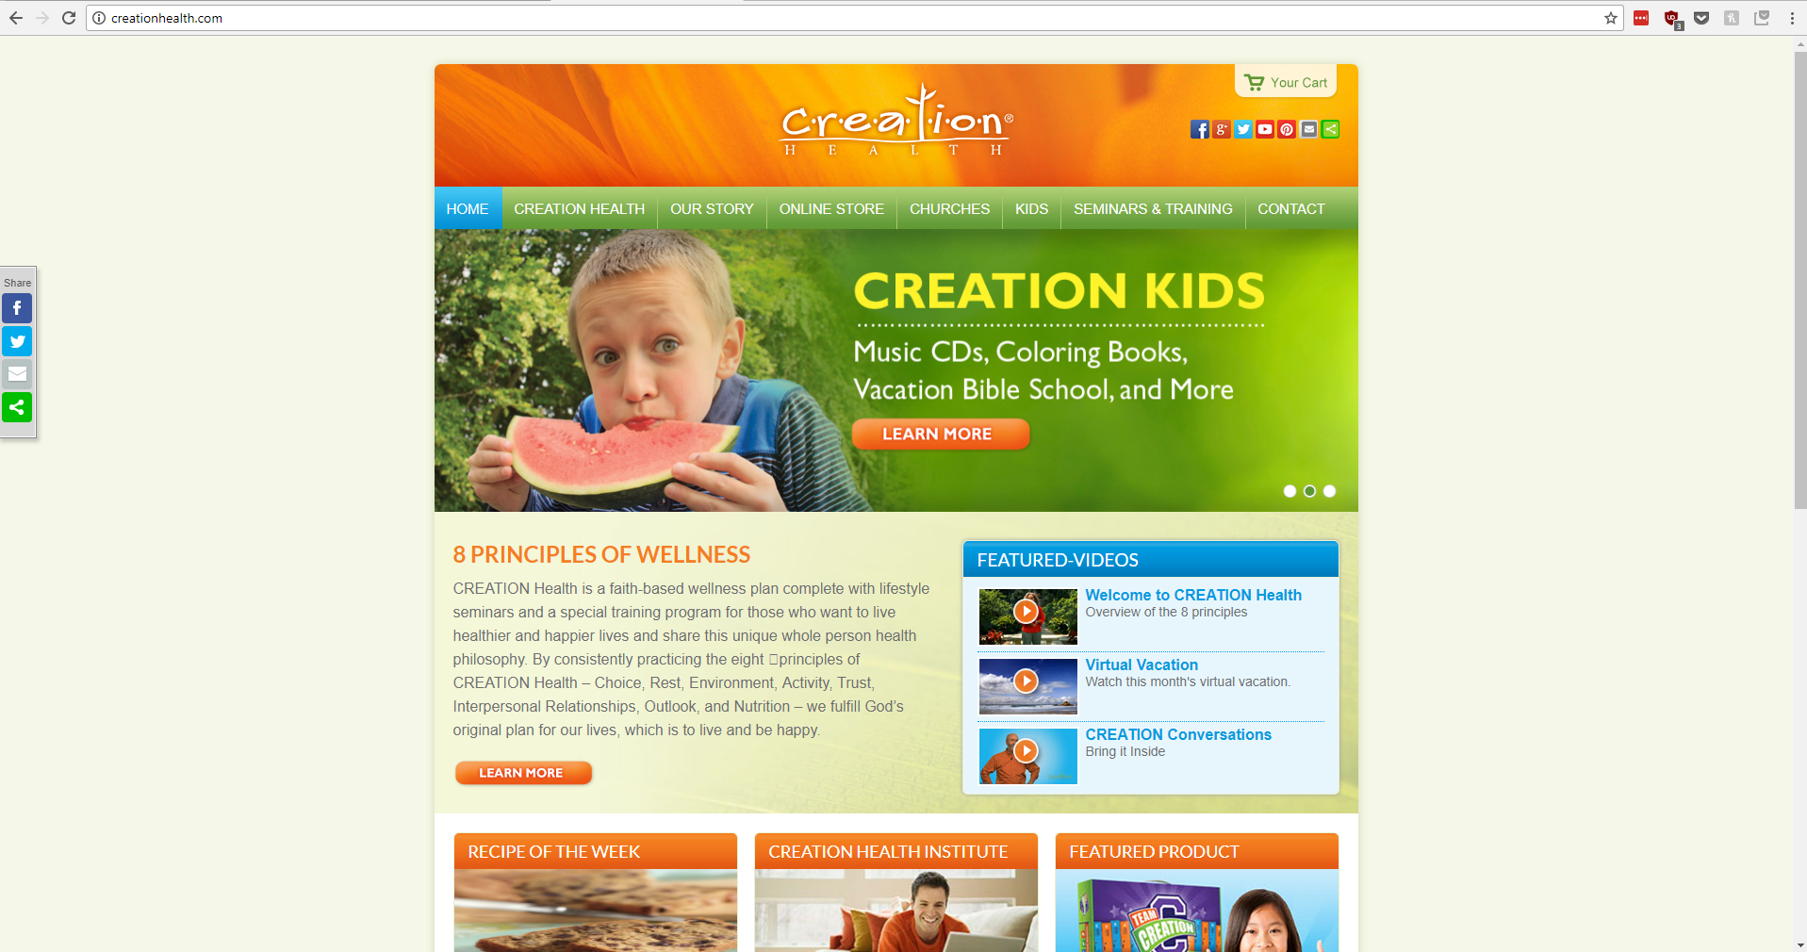
Creation Health
Outdated Design
Not mobile-friendly
Low traffic

Slide 4
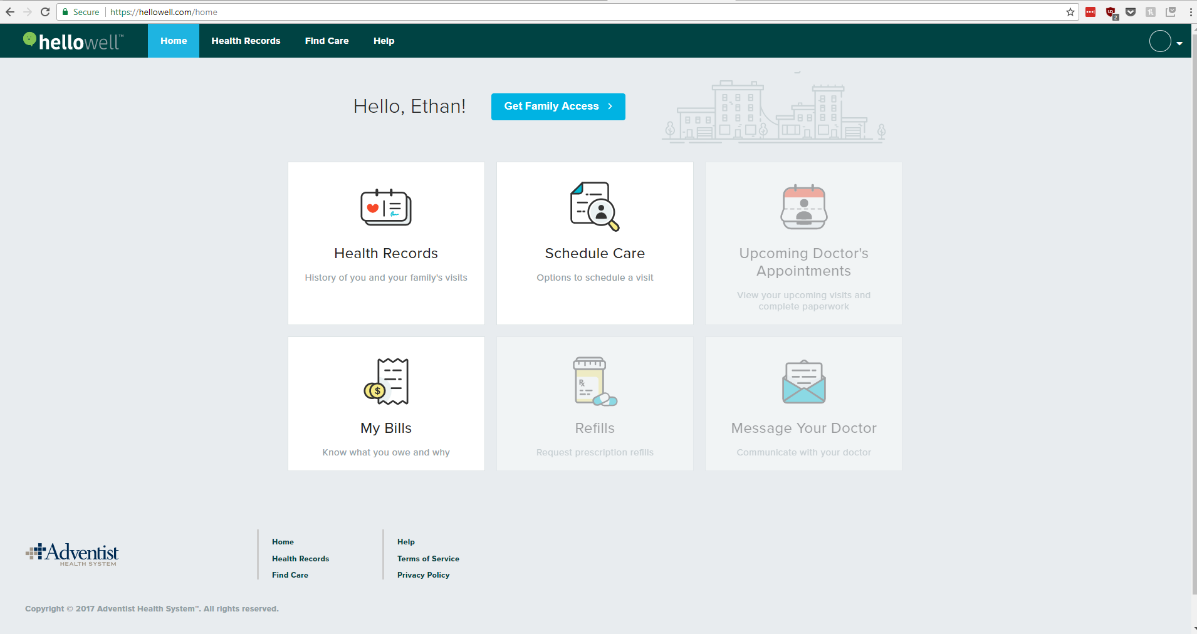
HelloWell
Current Consumer-facing application
No Creation Health data

Slide 5
Project Description
Take the content from Creation Health and make it available to Hello Well via an API.
Migrating the data from Creation Health
  Move to dynamic format, in a database
  Usable by Hello Well
  Accessible by users
Users can register to receive Creation Health tips and advice at scheduled intervals

Slide 6
System Design & Project Overview
Project Goals and Criteria

Slide 7
Part 1: Database Creation and Data Migration
Obtained existing Creation Health Data
Extended existing HelloWell database to hold Creation Health information
Migrated data into the newly extended database
Created Database representations for subscription-related data

Slide 8
Part 2: API Creation
Made Creation Health information accessible via API endpoints
Provided the ability to receive health tips via email notifications
Gave the option to choose the frequency of these notifications

Slide 9
Part 3: Testing
Added Unit Testing for API functionality
Implemented Unit Testing into Integration Testing and Continuous Integration Environments

Slide 10
Project Design Specifics

Slide 11

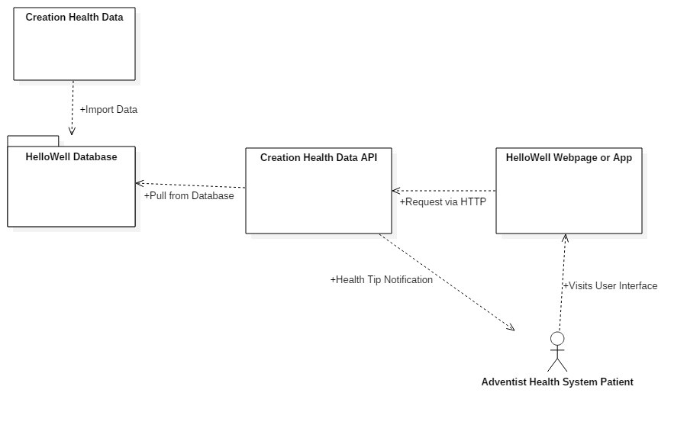
Data Flow

Slide 12
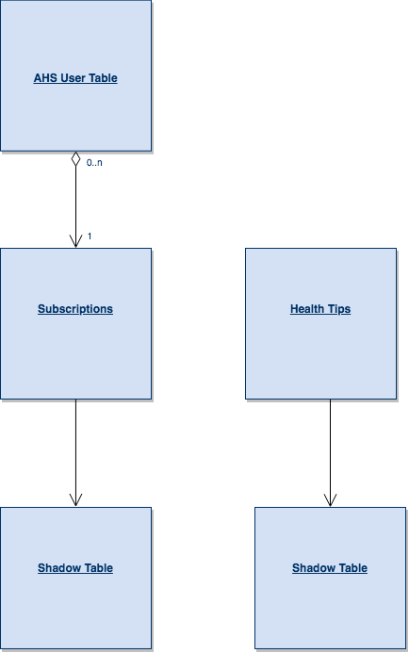
Database Structure

Slide 13
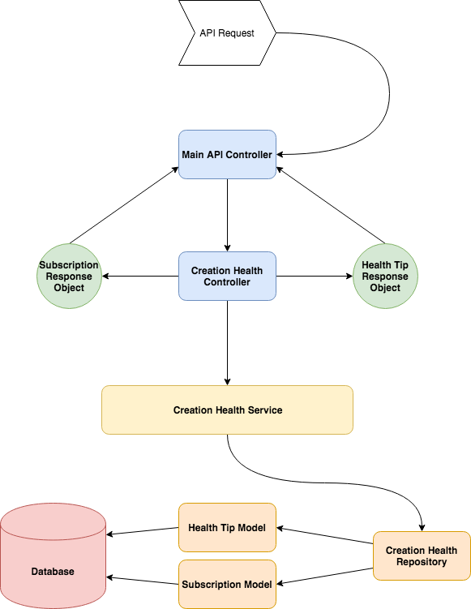
API Structure

Slide 14
API Endpoint Design
Endpoint functionalities:
Get all health tips
Get all health tips of a given type
Get specific health tip
Add/Change/Remove Subscription Level to health tips
Other functionality:
Send health tips via email

Slide 15
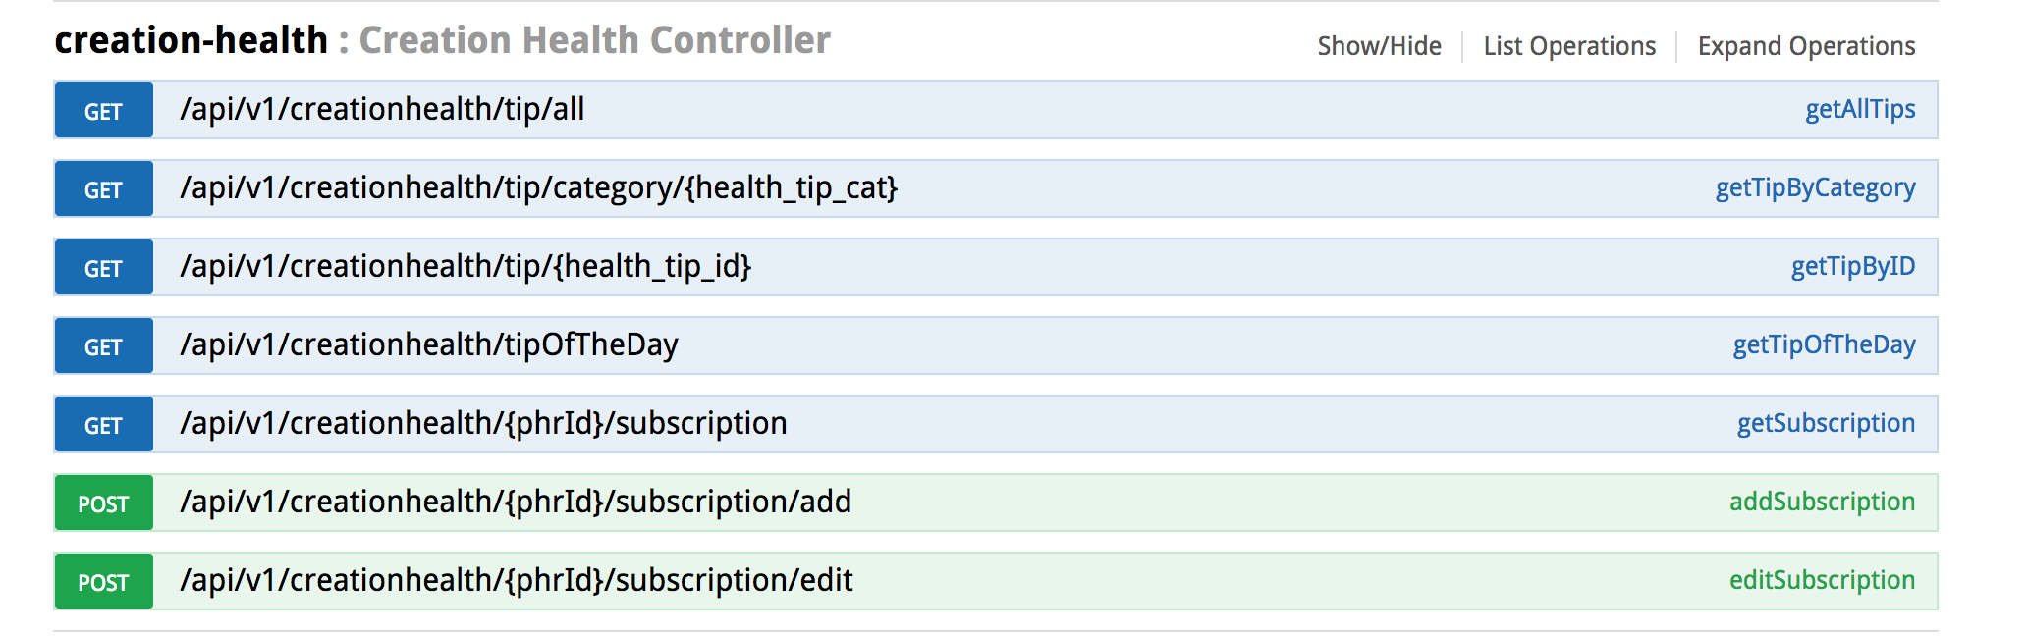
API Endpoint Design

Slide 16
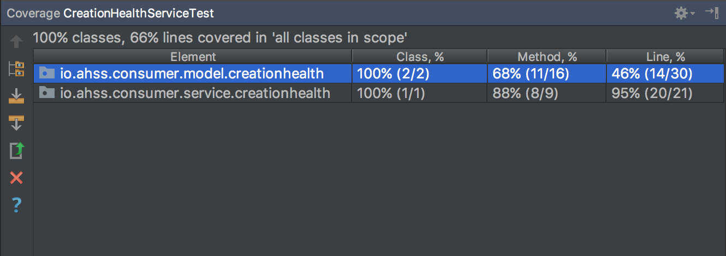
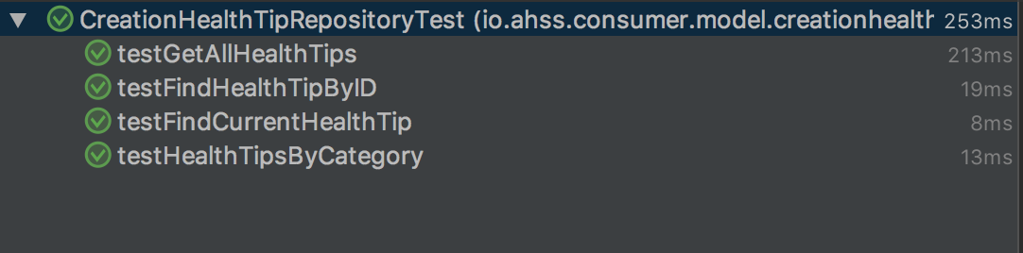
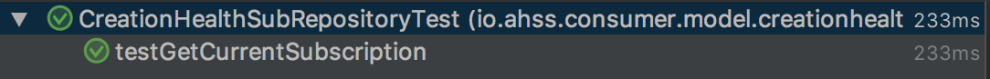
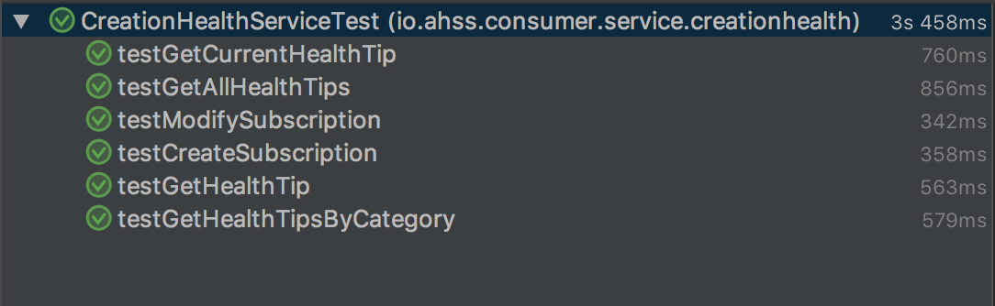
Testing

Slide 17
Demonstration

Slide 18
Review of Tools

Slide 19

Tools Used
Database: MariaDB with InnoDB
API: Java with Spring Boot
Testing: Junit, Mockito
Notes:
Why I chose them

Slide 20
Challenges Faced
Working with a large organization
  Led to large logistic delays and waiting periods
  Large overhead to getting started on portions of the project
Learning vast new technologies took significant time and effort

Slide 21
Future Development Opportunities
Possible future work for the project includes:
  Access newly available data in the Hello Well Web Application
  Finishing Email Notifications

Slide 22
Contact Information
Email: ethan.beaver@ahss.org

